Slide 1

EYE TRACKING BASED CONTROL SYSTEM FOR NATURAL HUMAN COMPUTER INTERACTION MINI PROJECT PRESENTED BY (A11) D.LAKSHMI MANASA(19481A1225) G.GOPI KRISHNA REDDY(19481A1231) M.NIKITHA(20485A1204) B.SAI KIRAN(19481A1209) UNDER THE GUIDANCE OF Mr B.SOBHAN BABU M.Tech (Ph.D) Assistant Professor, Department Of Information Technology. DEPARTMENT OF INFORMATION TECHNOLOGY SESHADRI RAO GUDLAVALLERU ENGINEERING COLLEGE , GUDLAVALLERU (An Autonomous Institute with Permanent Affiliation to JNTUK)

Slide 2
Contents
Introduction
Existing System
Proposed System
Software & Hardware Requirements
Design Methodology
Implementation
Result
Conclusion
References

Slide 3
ABSTRACT
The iris position will be located first and it will be mapped on the computer screen at a certain position.
This can be useful for the physically handicapped individuals to communicate with the computer and also do the work required with the help of the iris movement we can move the cursor up and down as well as left and right.
It also helps the person to make right and left movements of the mouse by blinking the eyes.

Slide 4
INTRODUCTION
Eye tracking technology, which is based on a eye tracker that measures the movement and positions of the eye has played an increasingly important role in psychology, marketing and user interfaces.
Eye trackers have existed for a number of years , but early in the development of the field of eye tracking, the use of eye trackers was largely confined to laboratory experiments to observe the nature of human eye movements, rather than to use these movements as an actual control medium within a HCI.

Slide 5
EXISTING SYSTEM
Some researchers have been attempting to establish techniques that help the elderly communicate with devices.
Many high-end techniques focused on eye movement monitoring to monitor computers were extremely costly and not available to those who wanted them.
In some available software, it difficult to predict the centroid of eye so we go for OpenCV.

Slide 6
PROPOSED SYSTEM
In our proposed system the cursor movement of computer is controlled by eye movement using OpenCV.
Camera detects the Eye ball movement which can be processed in OpenCV.
By this the cursor can be controlled.

Slide 7
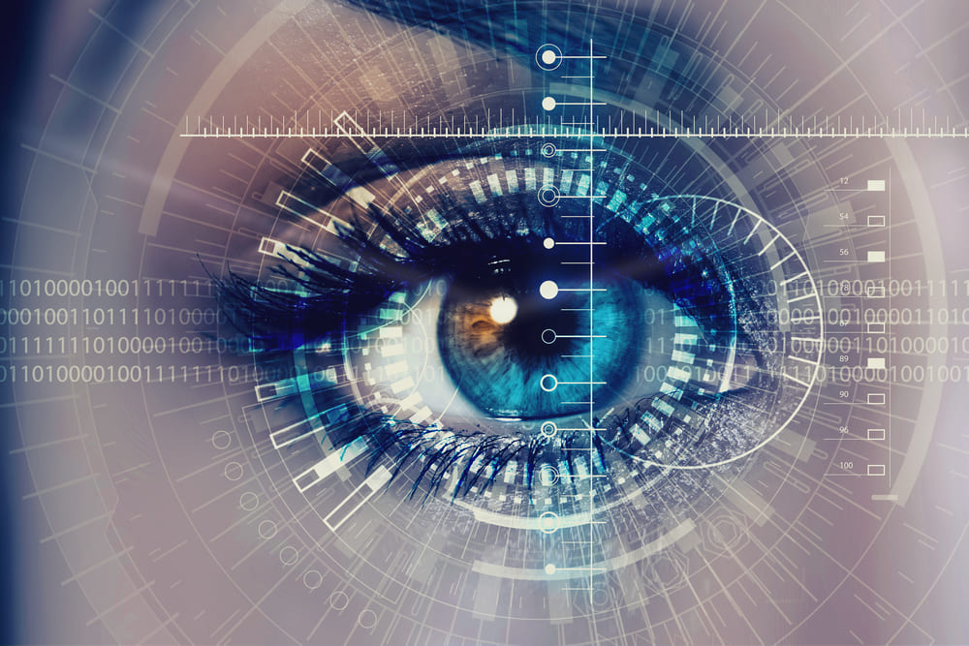
Software Requirements
Operating System: Windows10
Python
Python Libraries :
Numpy-1.13.3
OpenCV-3.2.0
PyAutoGUI-0.9.36
Dlib-19.4.0
Hardware Requirements
Intel Core i5
RAM: 8GB
Webcam or Integrated cam

Slide 8
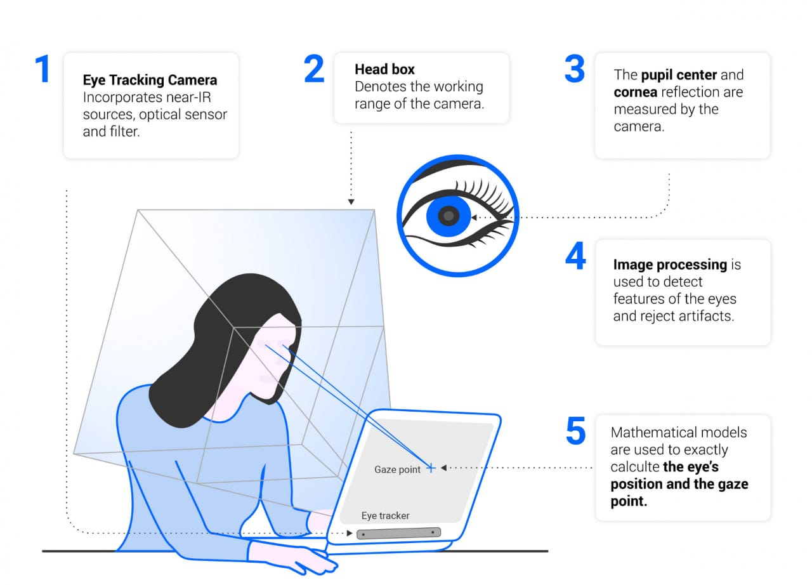
DESIGN METHODOLOGY

Slide 9
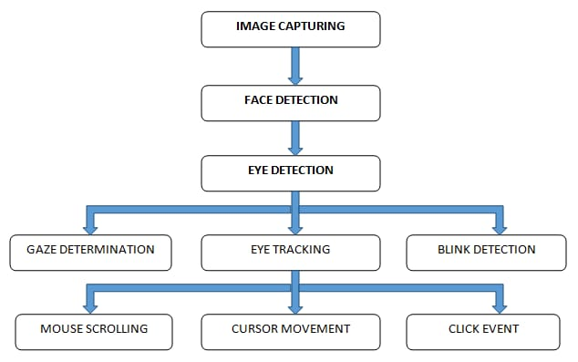
BLOCK DIAGRAM

Slide 10
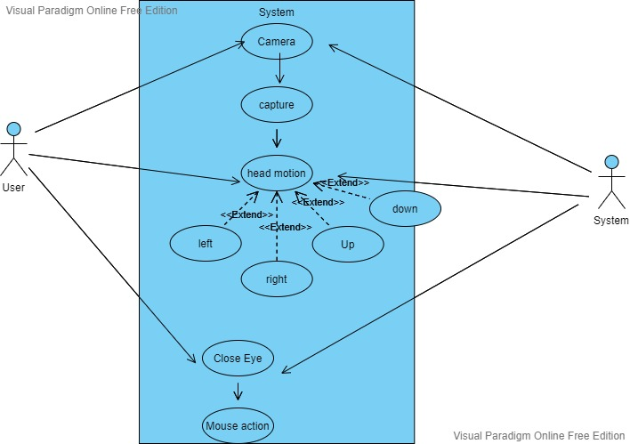
USE CASE DIAGRAM

Slide 11
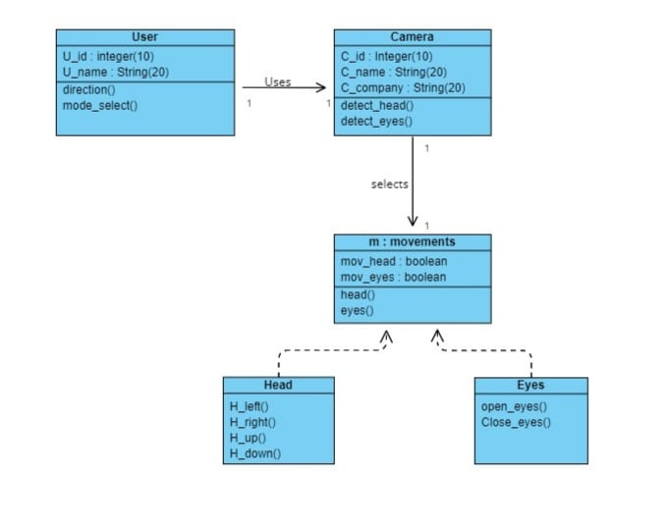
CLASS DIAGRAM

Slide 12
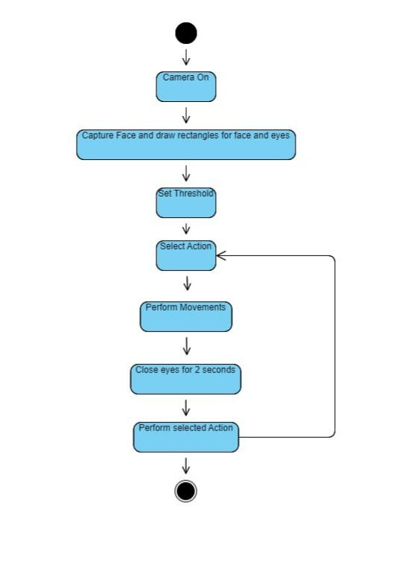
STATE CHART DIAGRAM

Slide 13
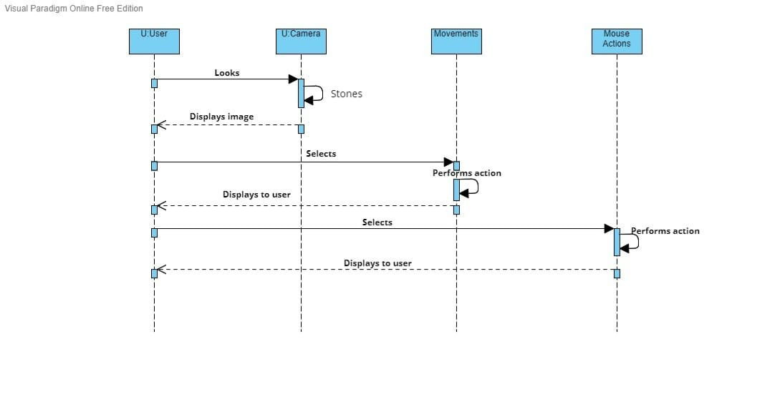
SEQUENCE DIAGRAM

Slide 14
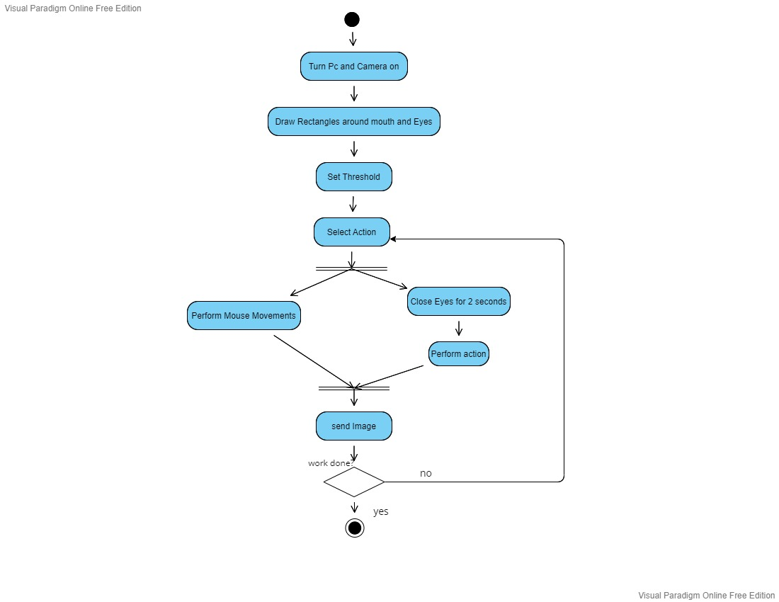
ACTIVITY DIAGRAM

Slide 15
IMPLEMENTATION
The following are the acts that make up the system proposed in this study:
1. Squinting your eyes
2. Winking
3. Head movement (pitch and yaw)
4. Opening your mouth
The project relies on the webcam to recognize facial functionality and place it in the cursor.
When the camera is open, the program must restore each image of the video. A framework after 1/30 seconds will be handled because the video frame rate usually has about 30 frames per second.
This technique is repeated for each frame as part of a loop. Face areas need to be recognized after frame removal. As a result, the images go through a series of image processing processes so that the computer can recognize features such as eyes, mouth, and nose.

Slide 16
The processing techniques are:
1.Resize:
On the y-axis, the first image is rotated 90 degrees. After that, the image must be resized. You can set the image resolution into any value you choose to use the resolution technique, depending on your needs.
2. Bgr to gray :
To generate more accurate results, the data we utilize to recognize the different areas of the face must be grey level.
3. Facial feature prediction and detection:
Face detection is handled by a method named " detector()'in models. The "prediction" tool can now be used to find facial features after a face has been recognized.
4. Mouth and eye aspect ratio:
Perspective ratio of mouth and eyes: after framing, the program needs a reference for shapes that, when contrasted, illuminate the product by any movement directed by these areas, such as blinking, yawning, etc.

Slide 17
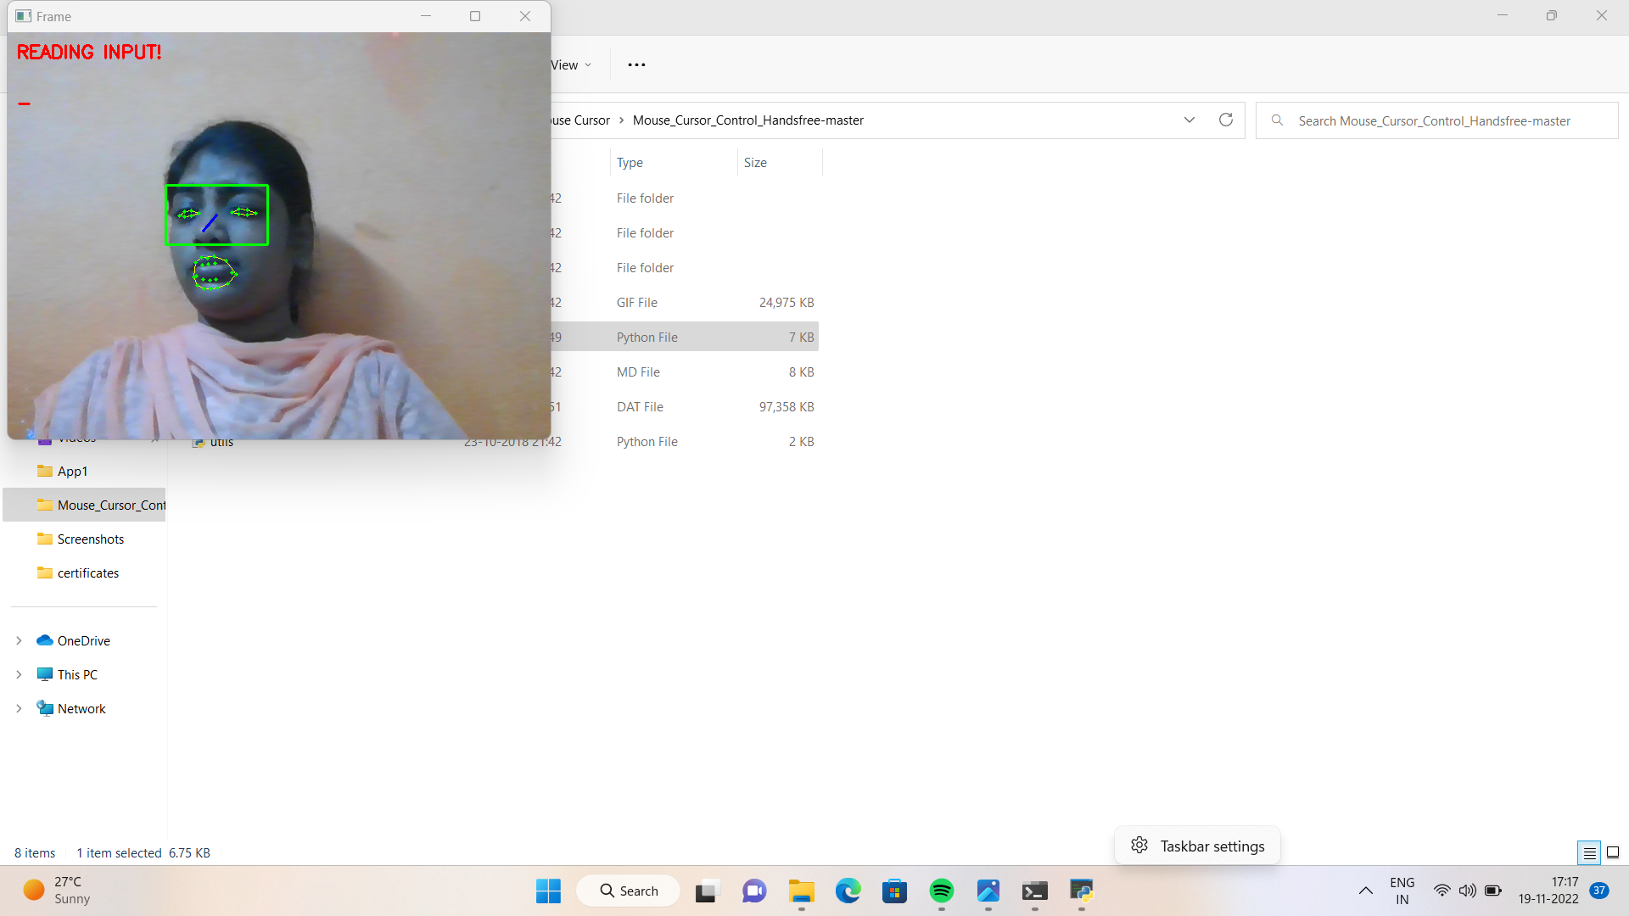
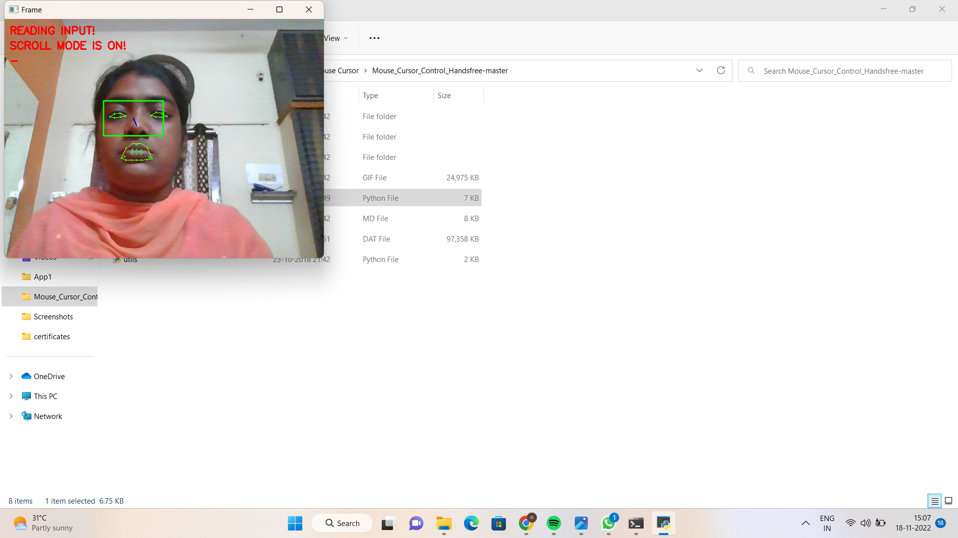
RESULT:
Fig: Activating The Project
Fig: Scroll Mode

Slide 18
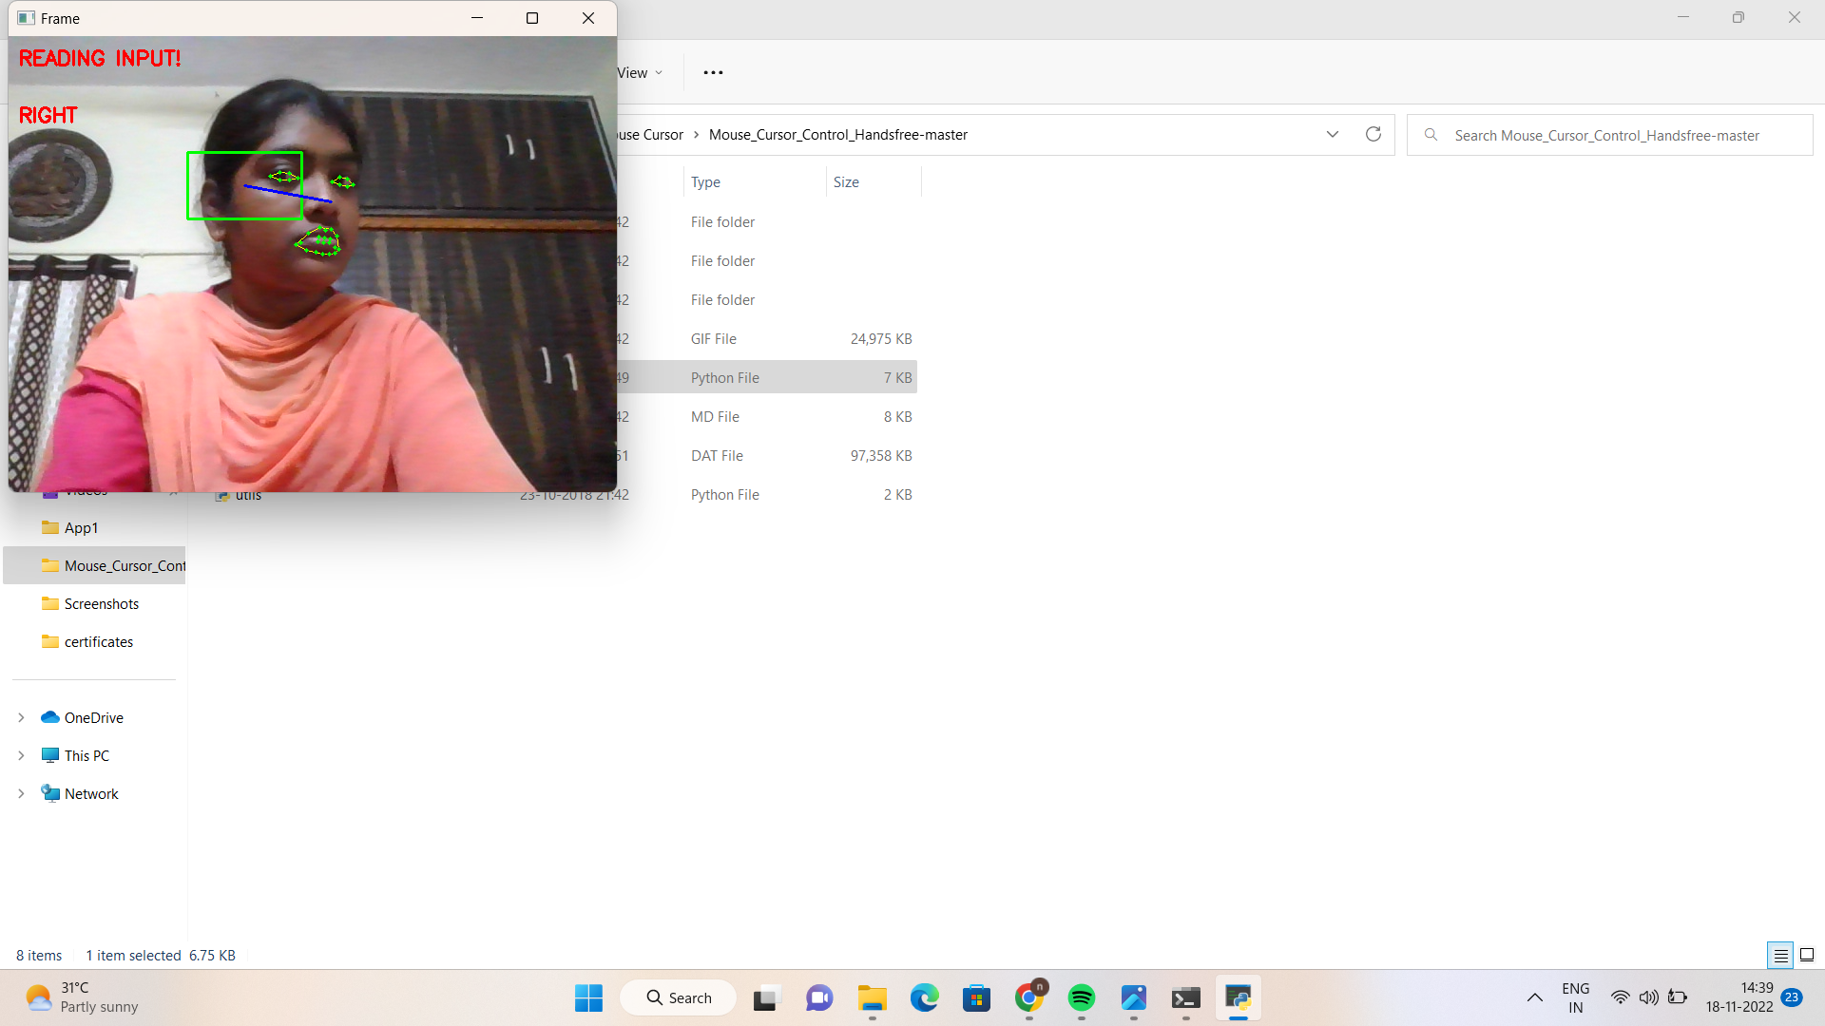
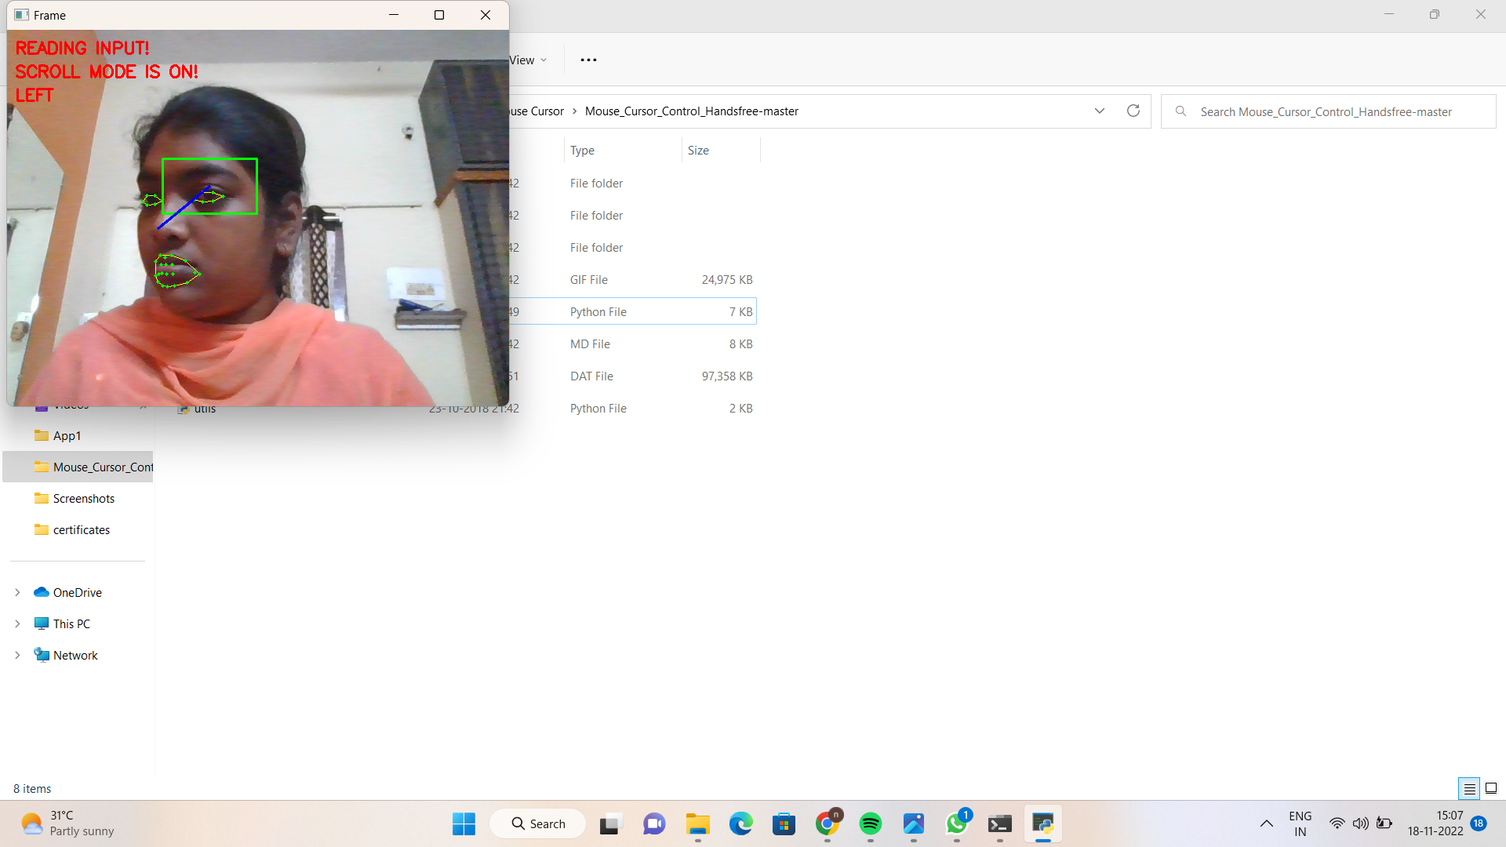
Fig: Scroll Right
Fig: Scroll Left

Slide 19
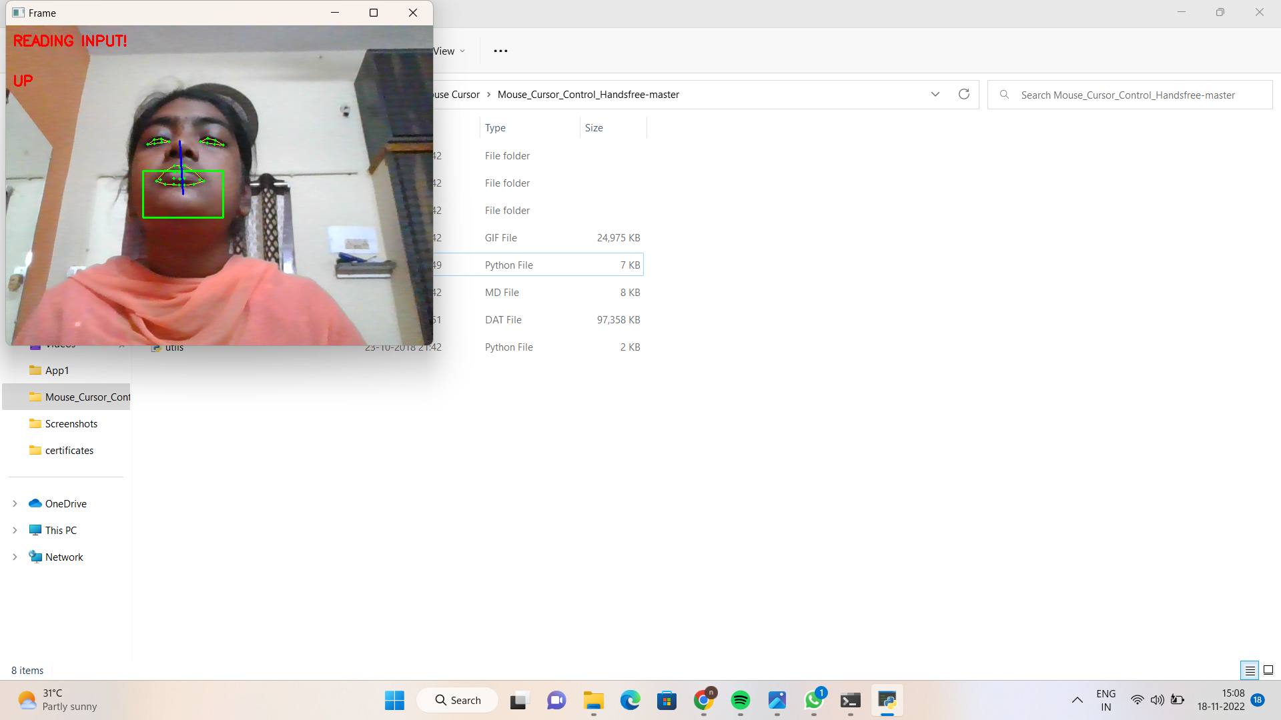
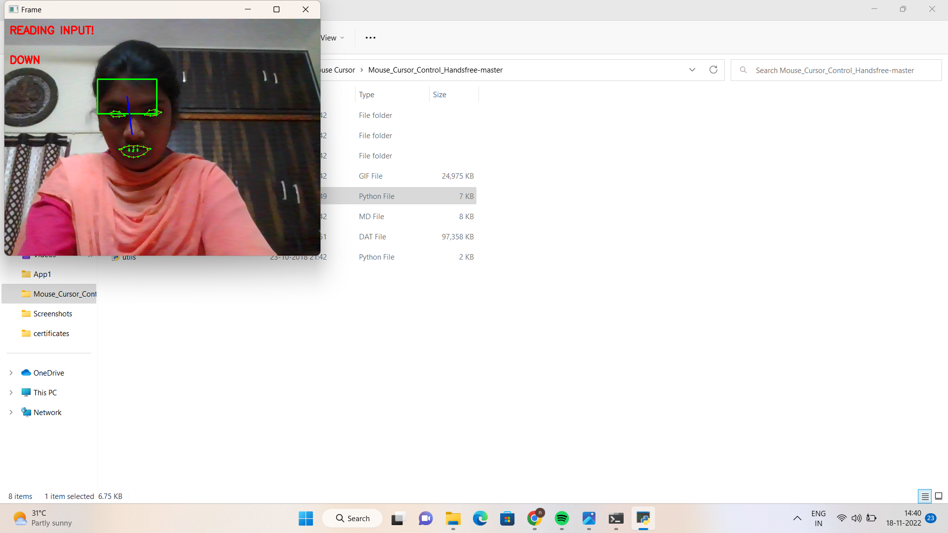
Fig. Scroll Up
Fig. Scroll Down

Slide 20
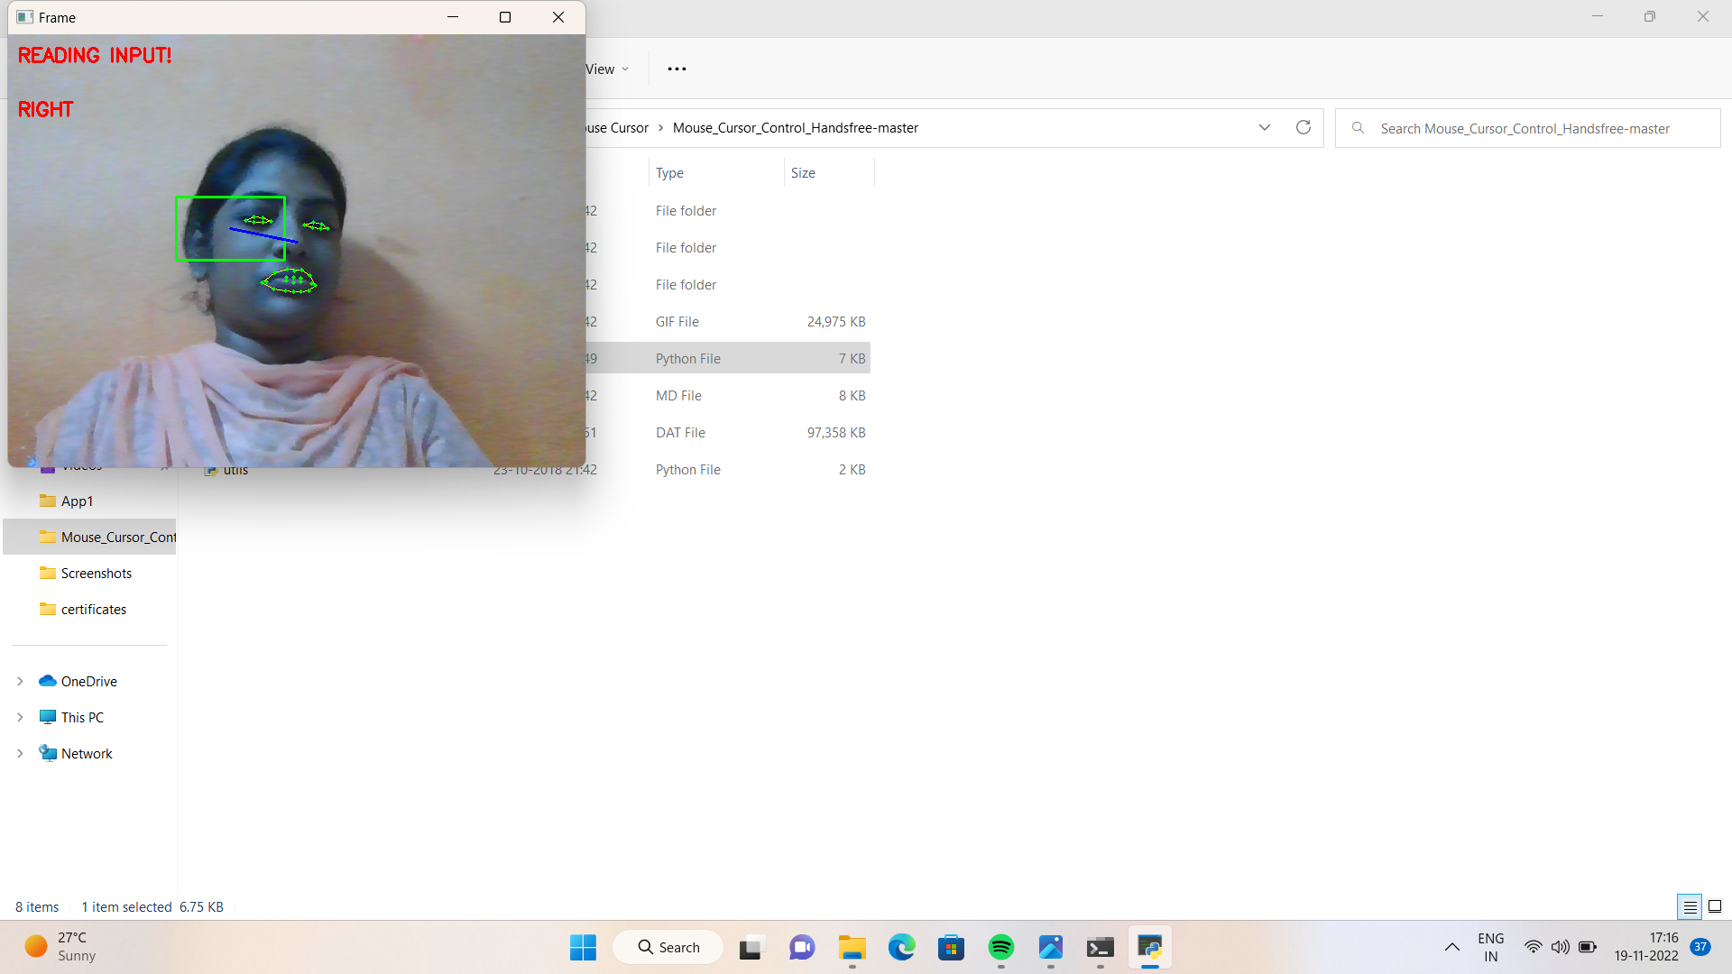
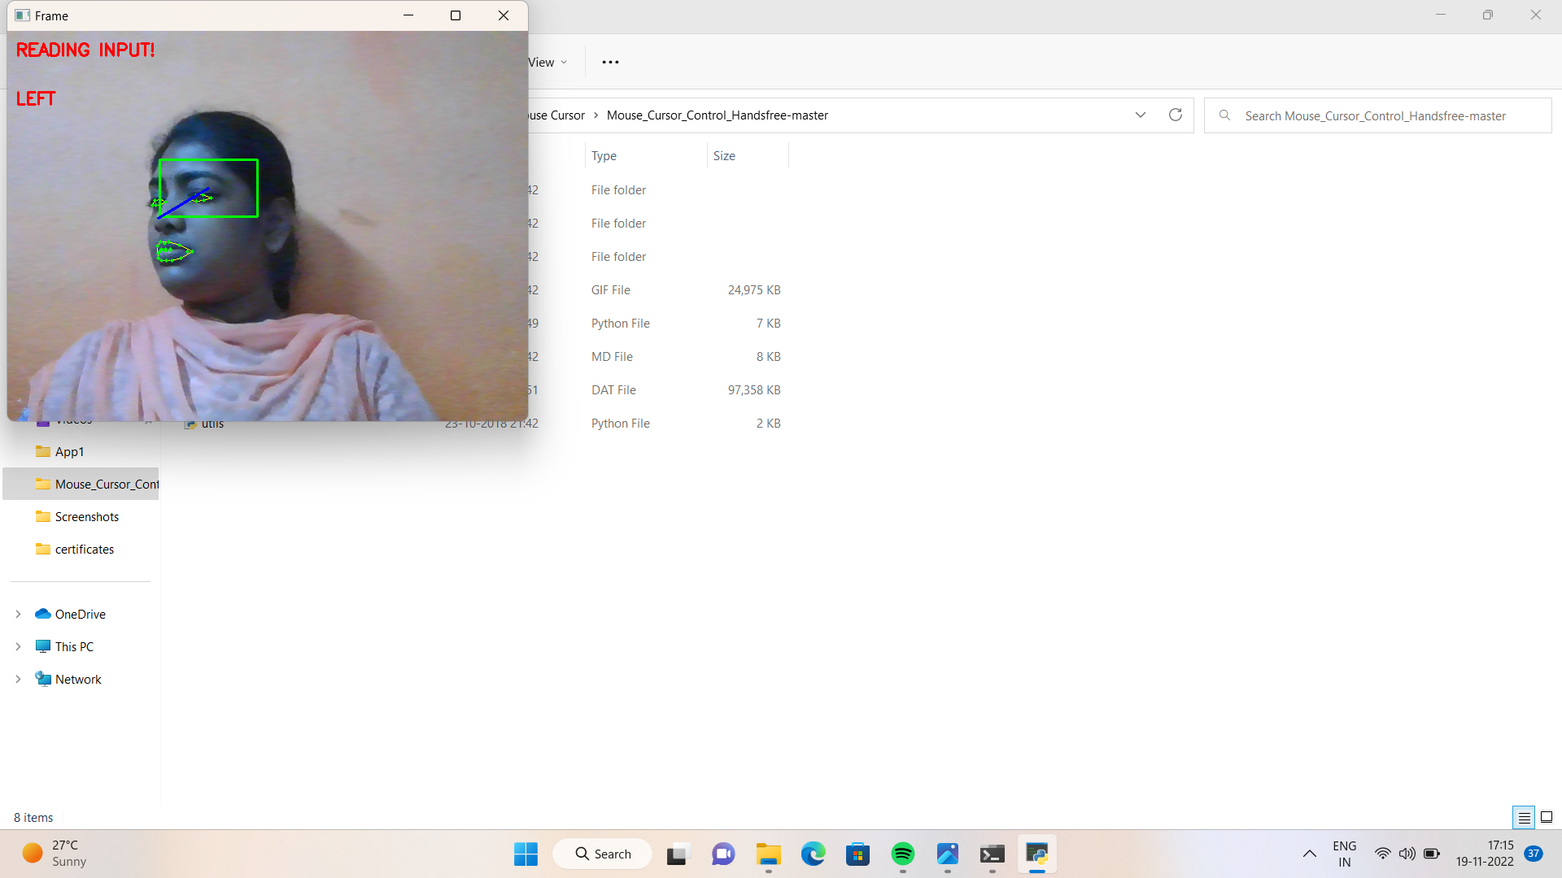
Fig .4.8. Right Movement Of Mouse
Fig. Left Movement Of mouse

Slide 21
CONCLUSION
In order to make user interact with computer naturally and conveniently by only using their eye, we provide an eye tracking based control system.
The system not only enables the disabled users to operate the computer the same as the normal users do but also provides normal users with a novel choice to operate computer.
Currently, this system is applied for the general operating behaviour to interact with computer by simulating mouse.
In future, we can add new operation functions for more usage situations for users to communicate with media and adjust our system on new platform, such as tablet or phone.

Slide 22
REFERENCES
D. G. Evans, R. Drew, and P. Blenkhorn, “Controlling mouse pointer position using an infrared head-operated joystick,”2000.
M. Betke, J. Gips, and P. Fleming, “The Camera Mouse: Visual Tracking of Body Features to Provide Computer Access for People With Severe Disabilities,” On Neural Systems And Rehabilitation Engineering, March 2002.
M. Nabati and A. Behrad, “Camera Mouse Implementation Using 3D Head Pose Estimation by Monocular Video Camera and 2D to 3D Point and Line Correspondences,” 2010 5th International Symposium on Telecommunications (IST'2010), 2010.
Y. L. Chen, F. T. Tang, W. H. Chang, M. K. Wong, Y. Y. Shih, and T.S. Kuo, “The new design of an infrared controlled human-computer interface for the disabled,” Dec. 1999.

Slide 23
THANK YOU

